Slide 1
CERN Huawei Collaboration
Tim Bell
Compute and Monitoring Group Leader
CERN IT

Slide 3


Slide 5
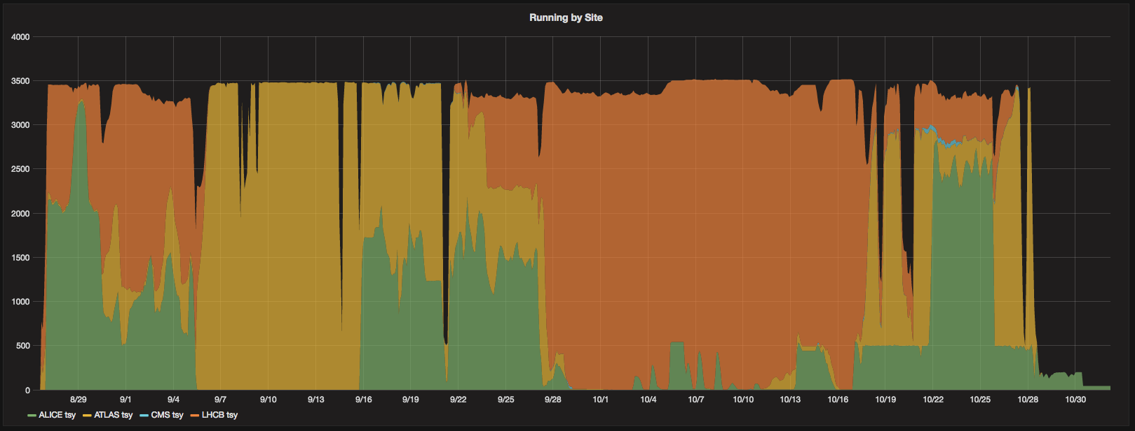
Open Telekom Cloud Cores Usage

Slide 6
Backup Slides

